Slide 1
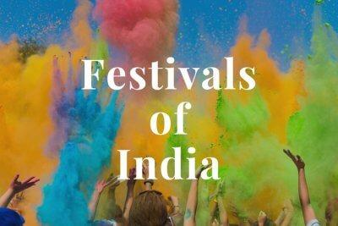
Festivals are celebrated to remember the events occurred on that particular day.

Slide 2
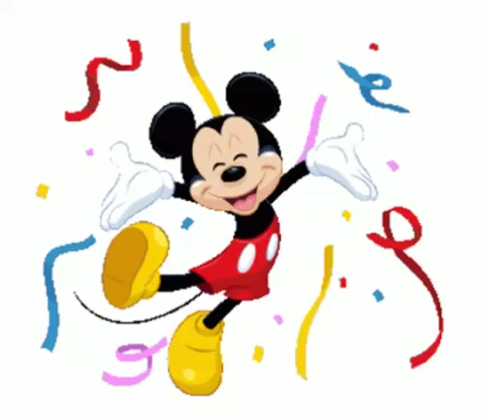
Religious festival
Lightening of diyas and candles
Diwali
Festival of lights
Fire works

Slide 3
Welcome spring season
Celebrated in the month of March
Holi
Colored powders and colored waters
Festival of colors

Slide 4
Marks a fresh new beginning
The effigies of Ravana, his brother and his son are burnt
Dussehra
Marks the end of Durga Puja
Navratri - Dhandia

Slide 5
Celebrated on 25th December
Religious festival
Christmas
Birthday of Jesus Christ
Decorate Christmas tree

Slide 6
Religious festival
30 days fasting
Ramzan
Ninth month in Islamic calendar
People do namaaz on this festival day

Slide 7
Harvest festival of Kerala
Floral decoration
Onam
Special food – Onam Sadhya
Boat race and Kaikottikali dance

Slide 8
Harvest festival of Tamil Nadu
Thank the Sun God
Pongal
Special food-Pongal
Decorate cattles and worship

Slide 9
Harvest festival of Punjab
Thanks giving puja for good harvest
Baisakhi
Celebrated by Sikhs
Celebrated in the month of April.

Slide 10
Harvest festival of Assam
Thank the Sun god and special food-Bohag
Bihu
Assamese- music, dance and feast
Celebrated in the month of April

Slide 11
National festival
Aug 15th, 1947
Independence day
Freedom
Prime minister hoist the national flag

Slide 12
National festival
Celebrated on January 26th
Republic day
The president of India hoists the flag at Rajpath.
Constitution of India

Slide 13
National festival
Celebrated on October 2nd
Gandhi Jayanthi
Birthday of a Freedom fighter
Mahatma Gandhi

Slide 14
National Festival
Celebrated on 14th November
Children's Day
Chacha Nehru who is fond of children
Birthday of our First prime minister

Slide 15
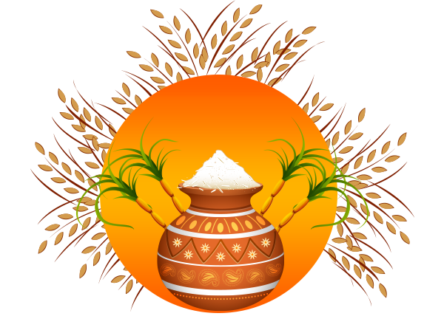
Identify the festival!
Pongal

Slide 16
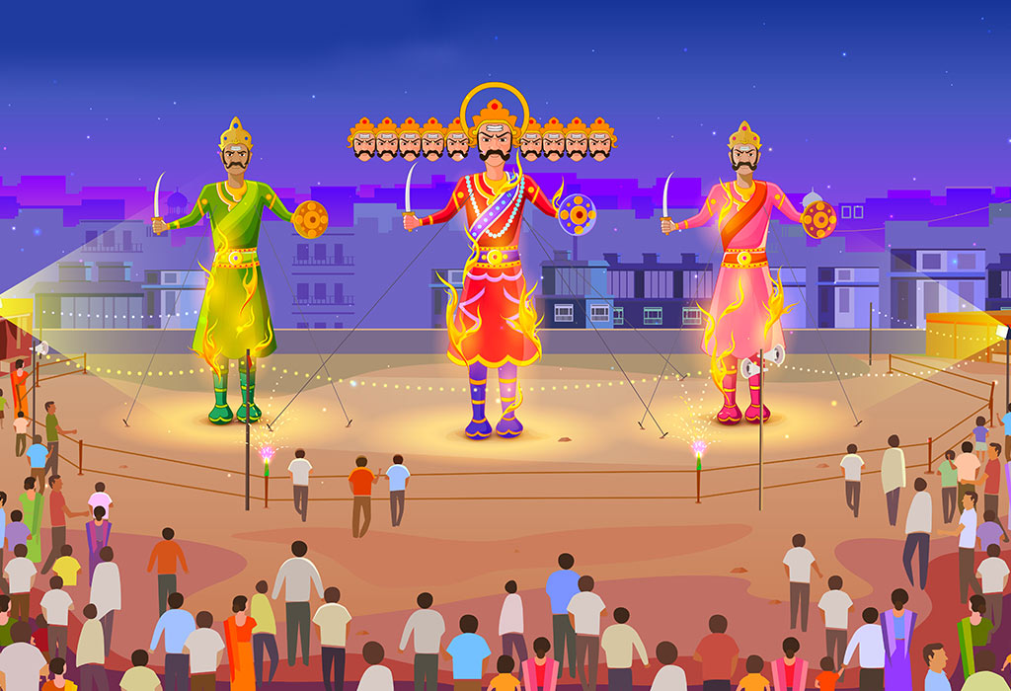
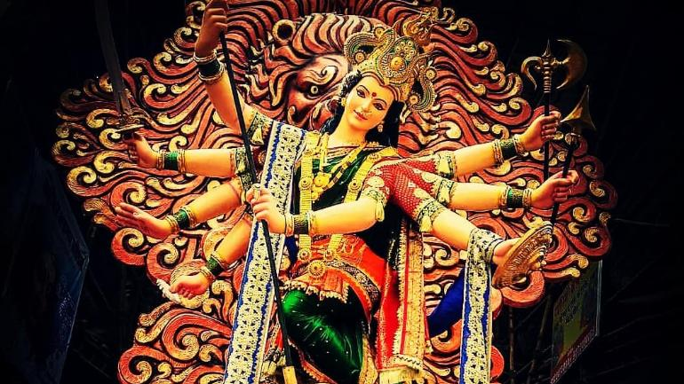
Identify the festival!
Dussehra

Slide 17
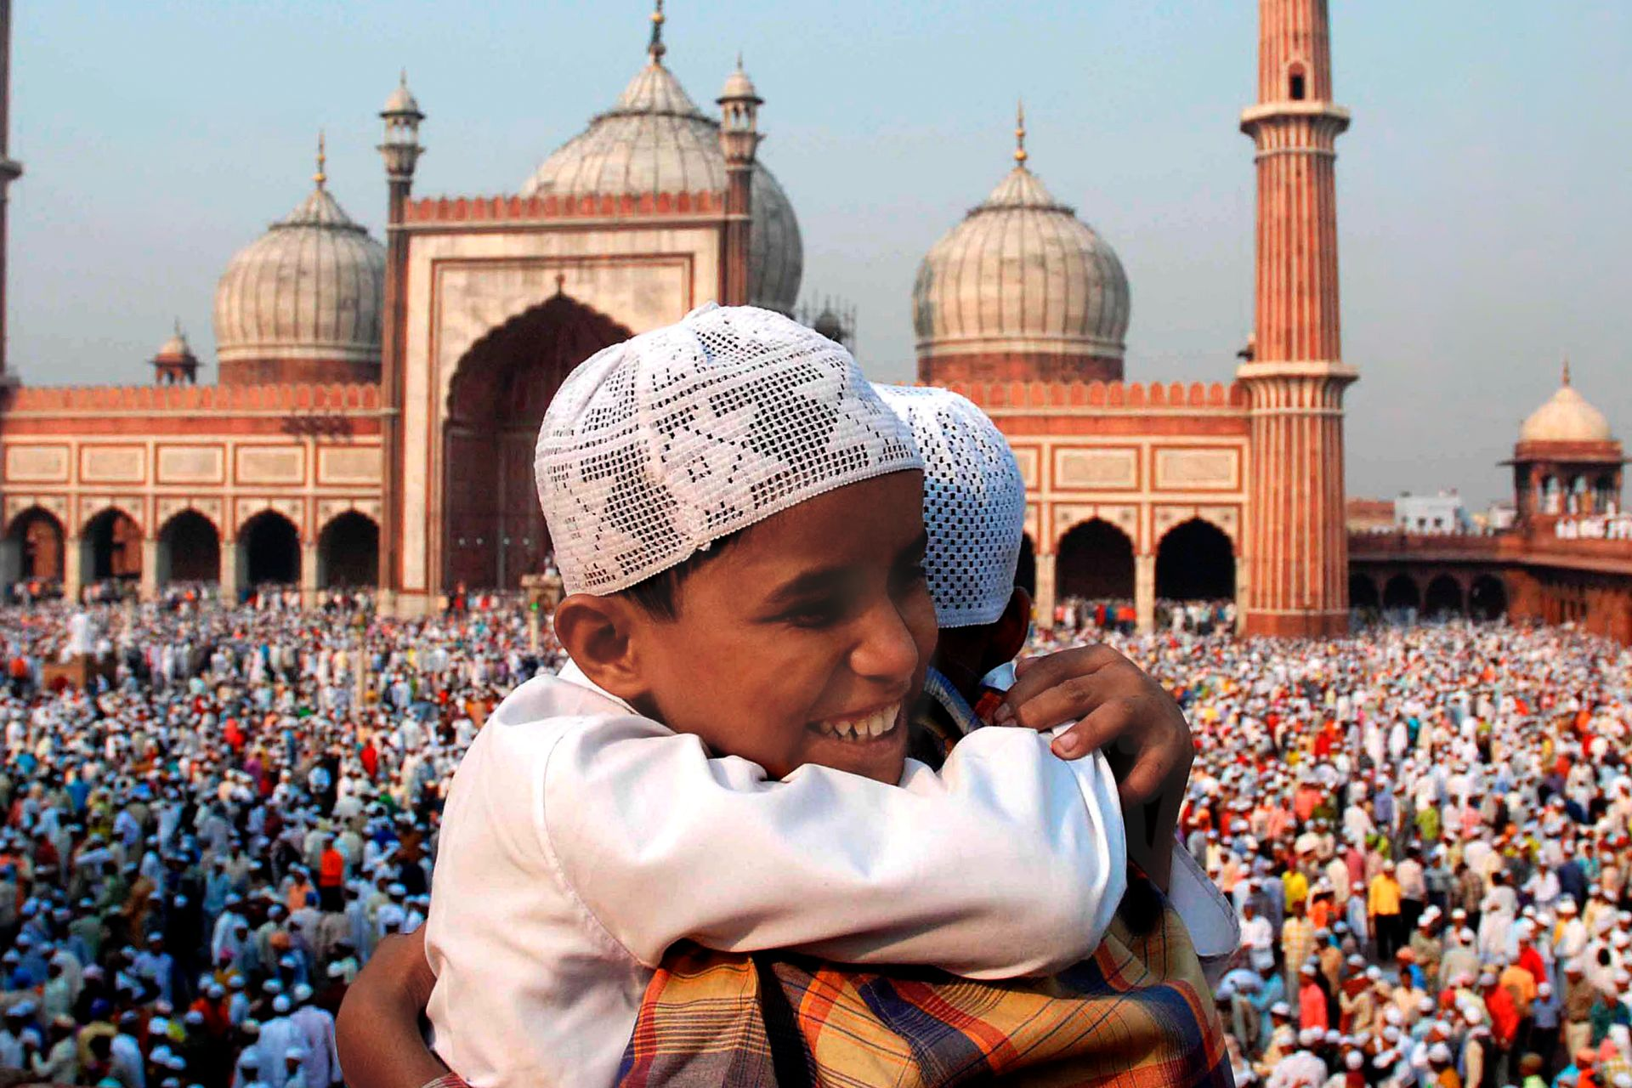
Identify the festival!
Eid

Slide 18
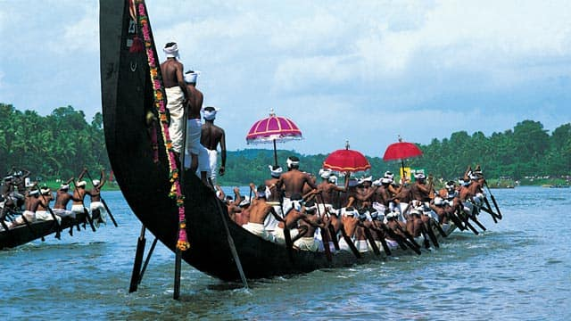
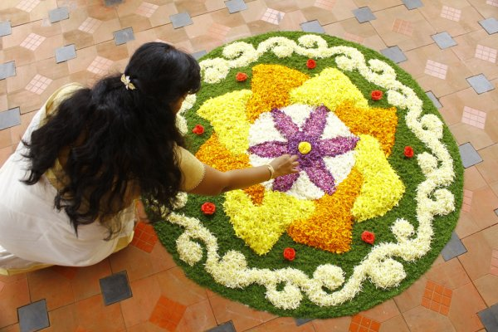
Identify the festival!
Onam

Slide 19
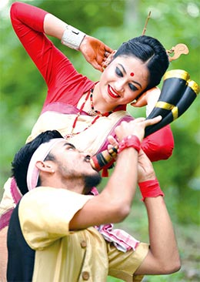
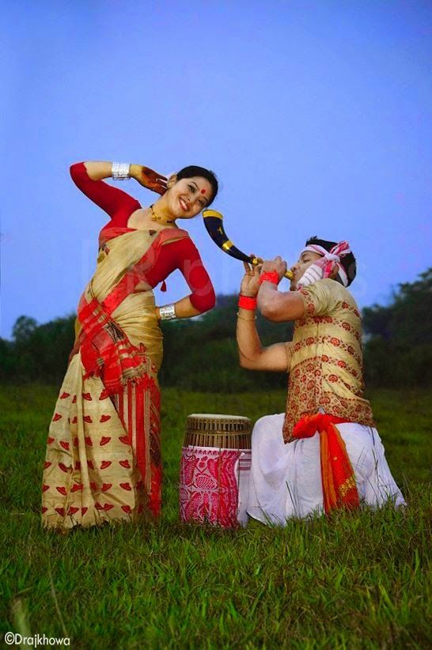
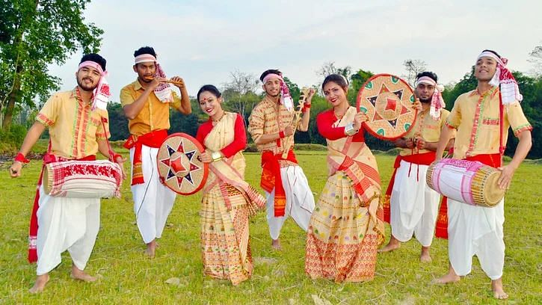
Identify the festival!
Bihu

Slide 20
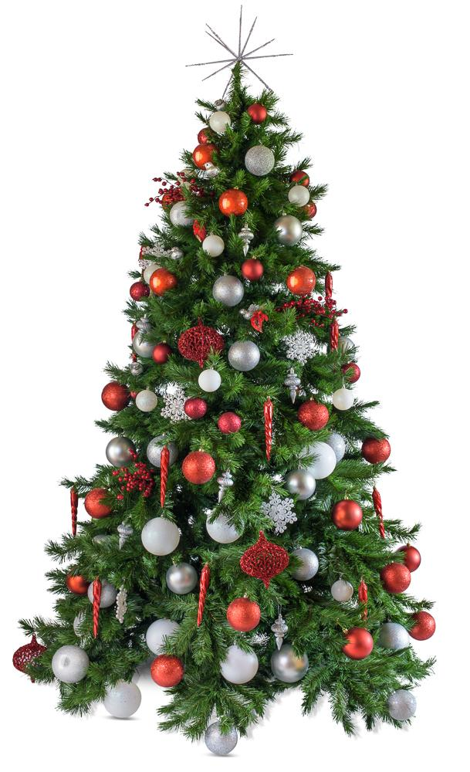
Identify the festival!
Christmas

Slide 21
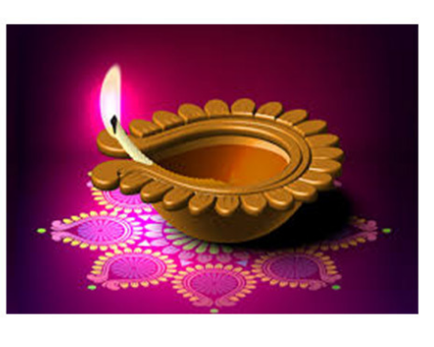
Identify the festival!
Diwali

Slide 22
Homework
EVS 2B Workbook
Page 21

